Slide 1

Content-Aware Personalized Editing Software
Image Processing for Data Engineers 05.12.2025
Iskandar Akhundov, Ankit Lamsal, Alvin Yadav
BSc Physics and Data Science
Supervisor:
Prof. Wenzel Markus

Slide 2
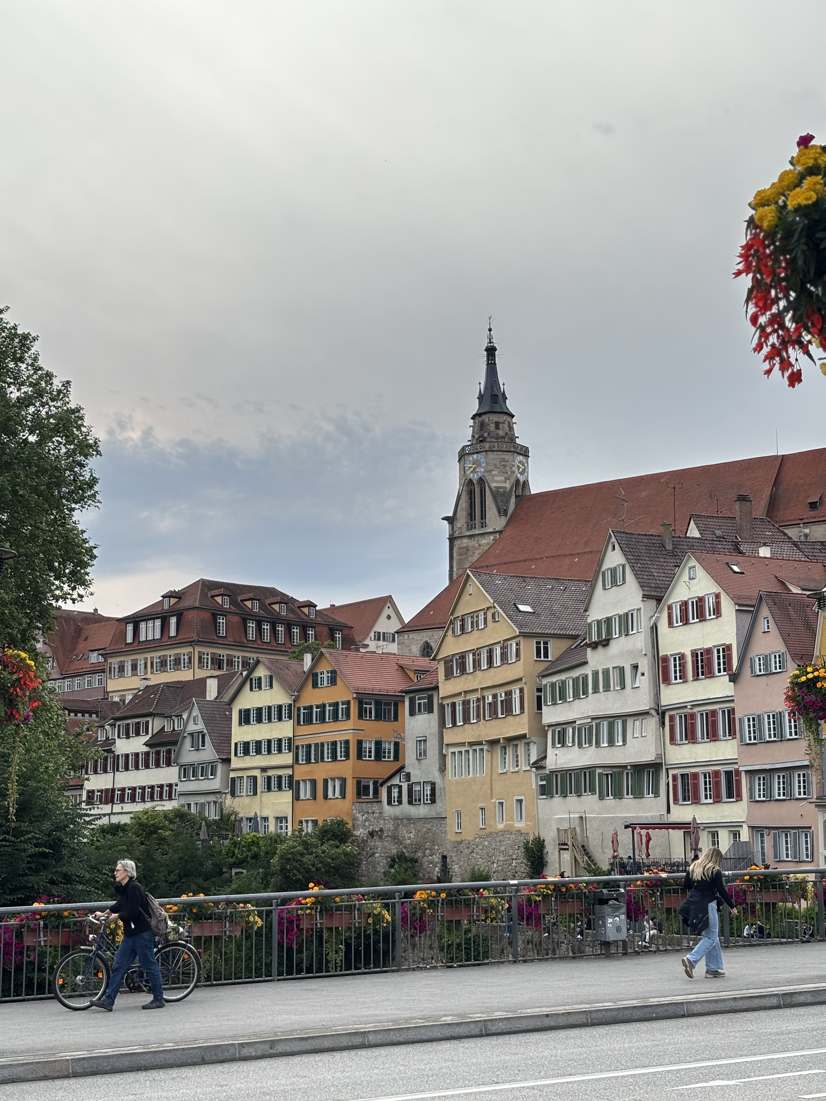
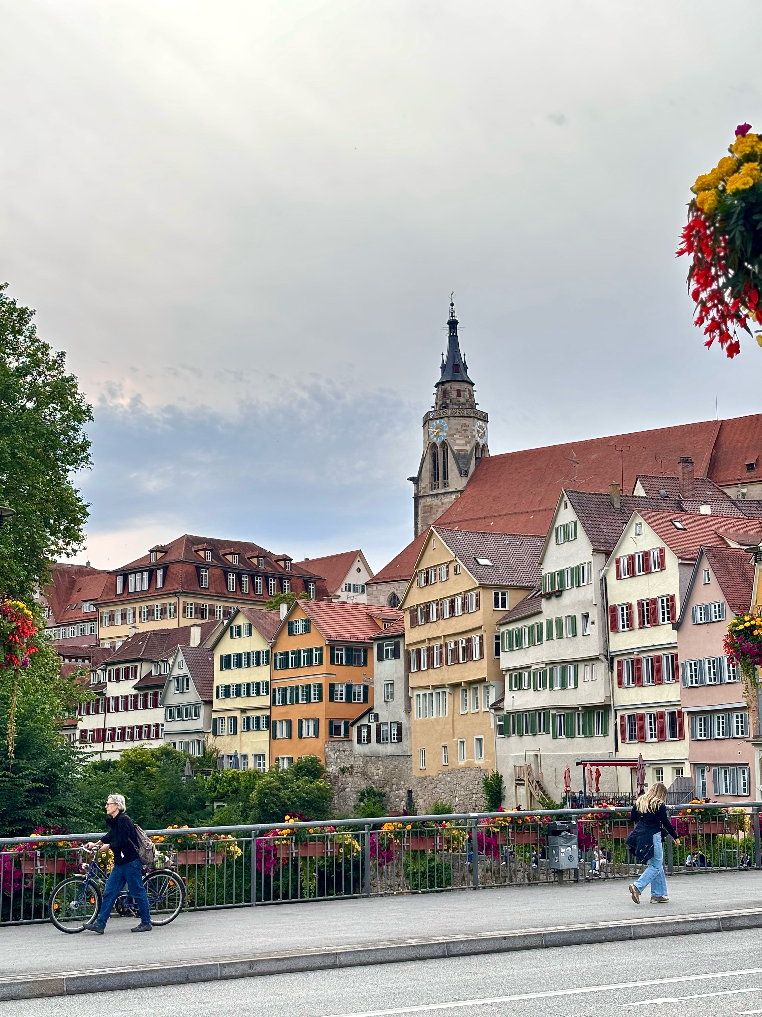
Motivation
Manual editing of same-style images are tedious and time consuming
Automate daily editing process by learning individual editing style
Preserve personalized editing style whilst being content-aware
Akhundov, Lamsal, Yadav
Image Processing for Data engineers: Project Presentation

Slide 3
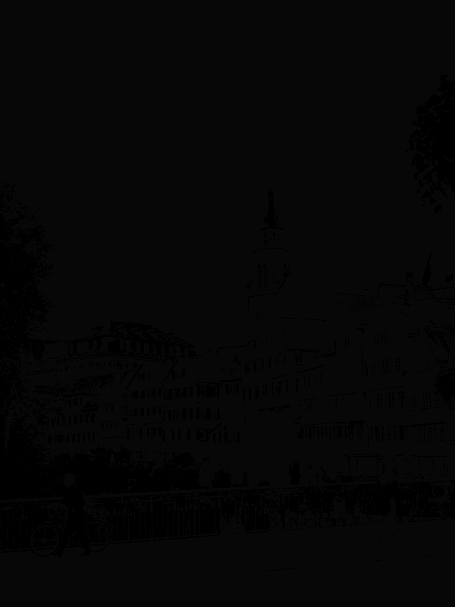
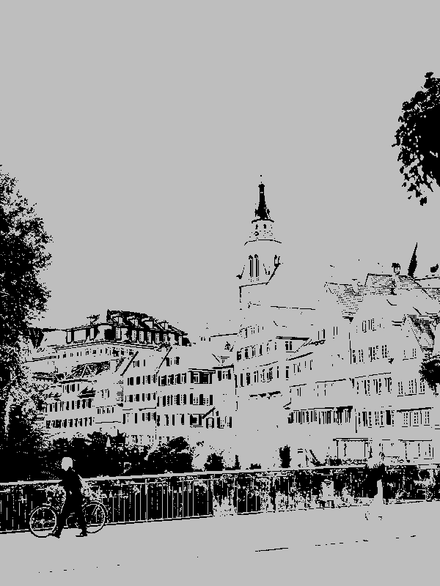
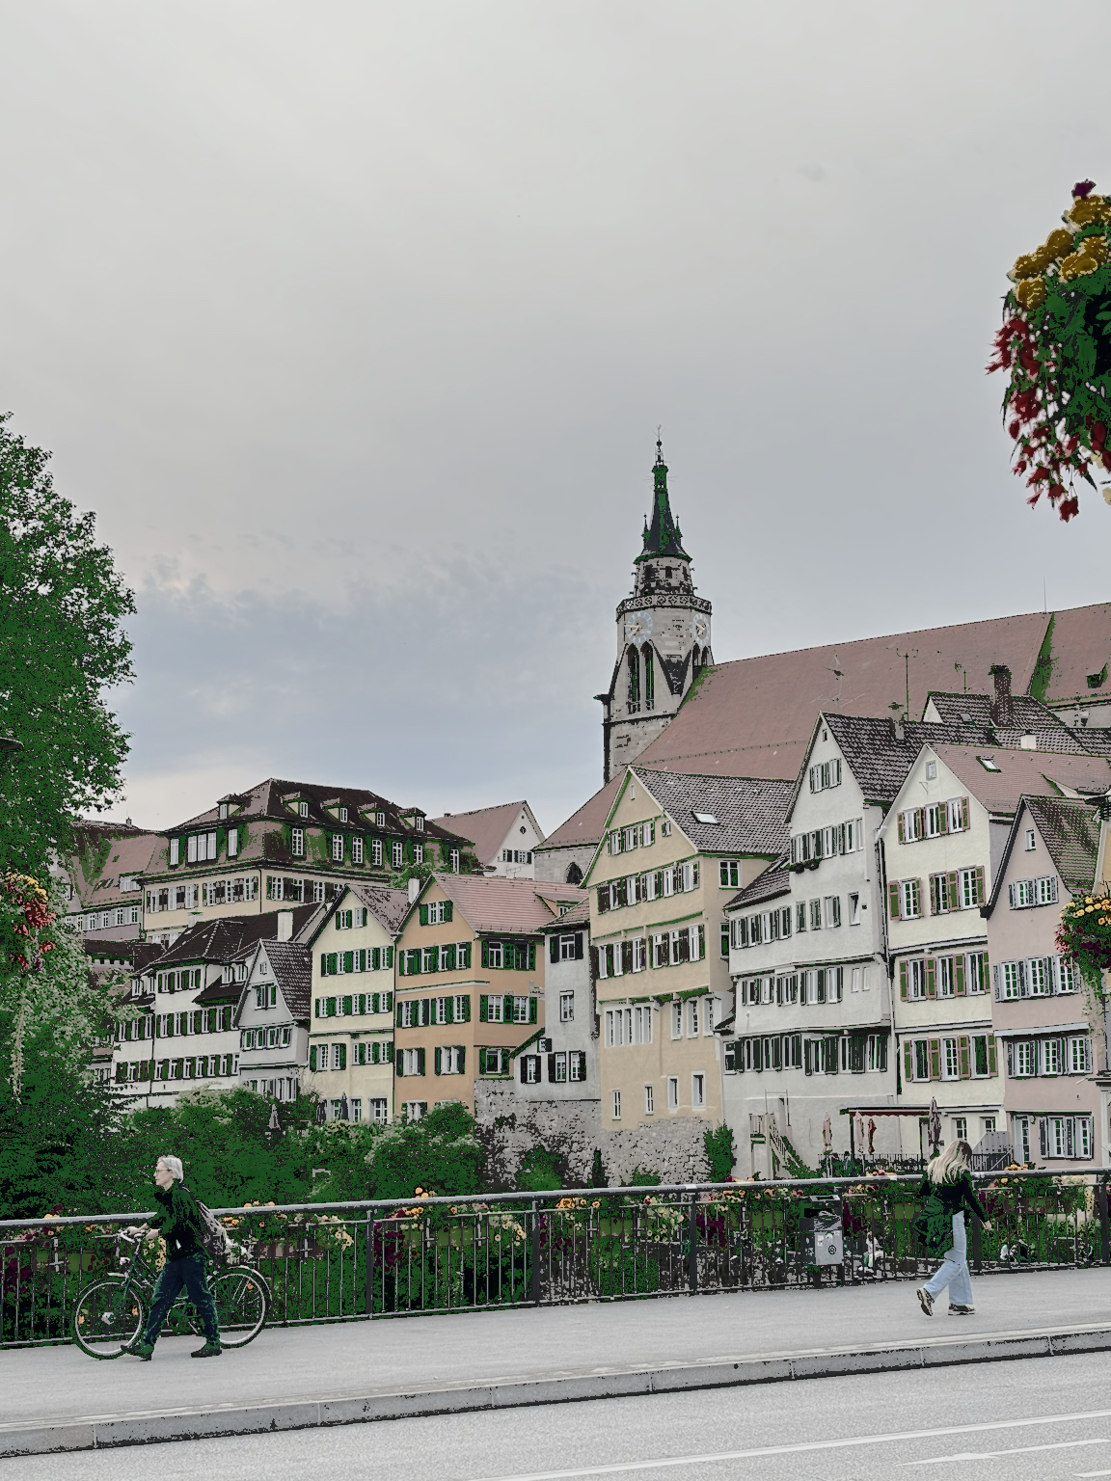
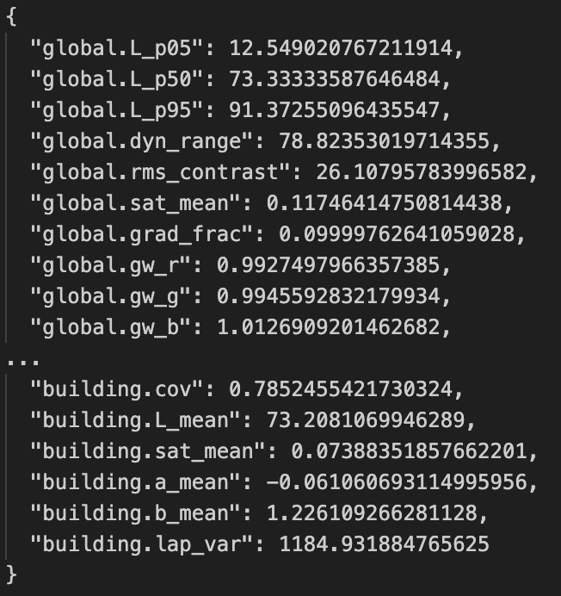
System Overview
UPLOAD
PERCEPTION
FEATURE EXTRACTION
Akhundov, Lamsal, Yadav
Image Processing for Data engineers: Project Presentation

Slide 4
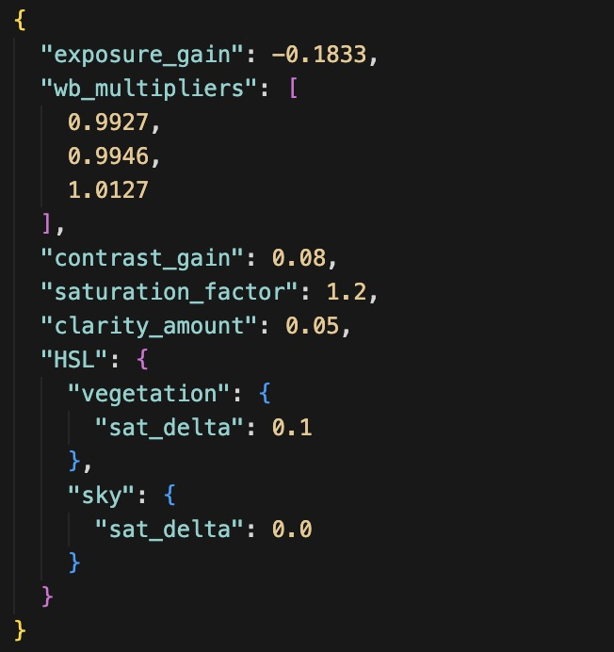
System Overview
STYLE MODEL
EDIT ENGINE
Akhundov, Lamsal, Yadav
Image Processing for Data engineers: Project Presentation

Slide 5
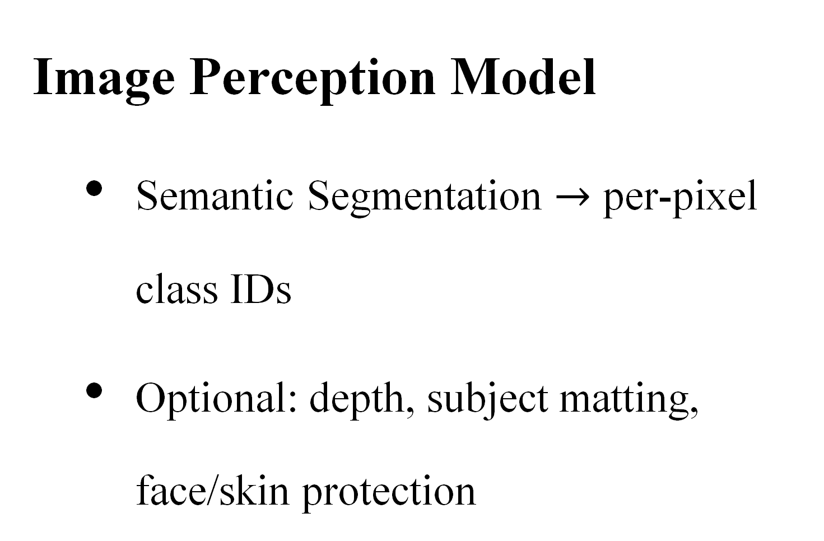
Two Model Setup
Image Perception Model
Semantic Segmentation $→$ per-pixel class IDs
Optional: depth, subject matting, face/skin protection
Style Editing Model
Learn your sliders from past edits
Predict sliders for a new image from feature
Akhundov, Lamsal, Yadav
Image Processing for Data engineers: Project Presentation

Slide 6
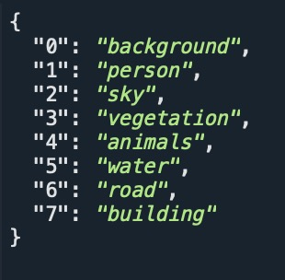
Image Perception Model
Class (IDs 0-7):
Annotation Options:
Label Studio: accurate, but slow and small dataset
SAM (Segment Anything Model): fast, large dataset, less accurate
Training (Pytorch):
Loss (per pixel Cross Entropy)
Metric (mIoU)
Akhundov, Lamsal, Yadav
Image Processing for Data engineers: Project Presentation

Slide 7
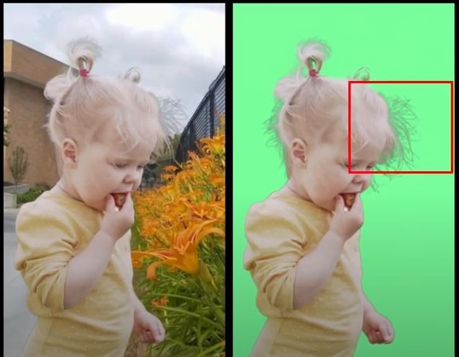
Perception: Further Sophistication
Matting
U²-Net / MODNet for soft subject matte
Better subject/sky boundaries
Akhundov, Lamsal, Yadav
Image Processing for Data engineers: Project Presentation

Slide 8
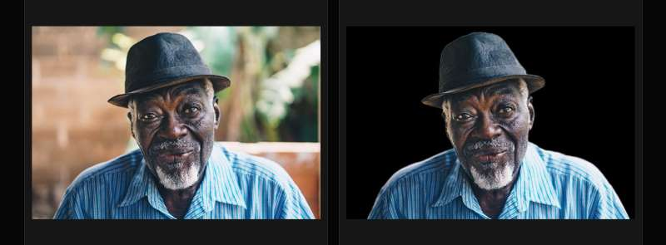
Perception: Further Sophistication
Matting
U²-Net / MODNet for soft subject matte
Better subject/sky boundaries
Relative Depth
MiDaS/ZoeDepth for FG/BG falloffs
Depth-aware dehaze/clarity
Portrait Protection
Face detection, optional skin masks
Limit clarity/hue shifts on faces
Akhundov, Lamsal, Yadav
Image Processing for Data engineers: Project Presentation

Slide 9
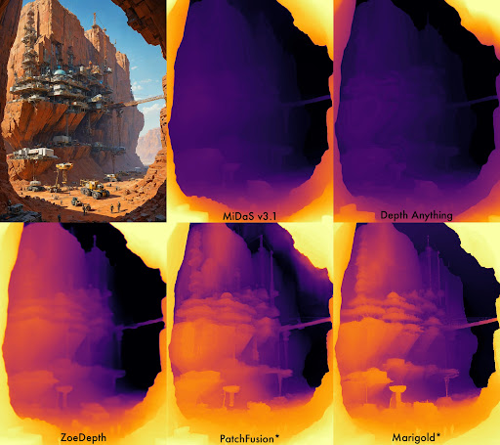
Portrait Protection
Face detection, optional skin masks
Limit clarity/hue shifts on faces
Perception: Further Sophistication
Matting
U²-Net / IS-Net/ MOD Net for soft subject matte
Better subject/sky boundaries
Relative Depth
MiDaS/ZoeDepth for FG/BG falloffs
Depth-aware dehaze/clarity
Relative Depth
MiDaS/ZoeDepth for FG/BG falloffs
Depth-aware dehaze/clarity
Akhundov, Lamsal, Yadav
Image Processing for Data engineers: Project Presentation

Slide 10
Perception: Further Sophistication
Matting
U²-Net / IS-Net/ MOD Net for soft subject matte
Better subject/sky boundaries
Portrait Protection
Face detection, optional skin masks
Limit clarity/hue shifts on faces
Relative Depth
MiDaS/ZoeDepth for FG/BG falloffs
Depth-aware dehaze/clarity
Akhundov, Lamsal, Yadav
Image Processing for Data engineers: Project Presentation

Slide 11
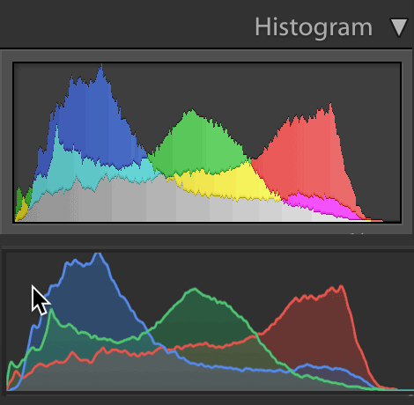
Feature Extraction
Global
L* channel (sorted by percentiles), dynamic range, RMS contrast
Mean saturation, high-gradient fraction
Gray-world WB gains
Akhundov, Lamsal, Yadav
Image Processing for Data engineers: Project Presentation

Slide 12
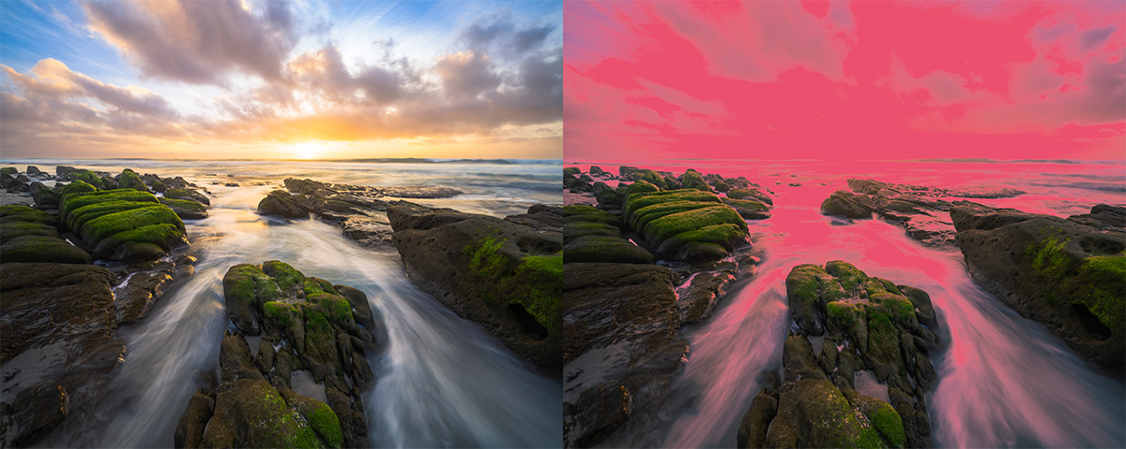
Feature Extraction
Per Region (each class)
Coverage; mean L*/a*/b*; mean saturation
Texture proxy: Laplacian variance
Akhundov, Lamsal, Yadav
Image Processing for Data engineers: Project Presentation

Slide 13
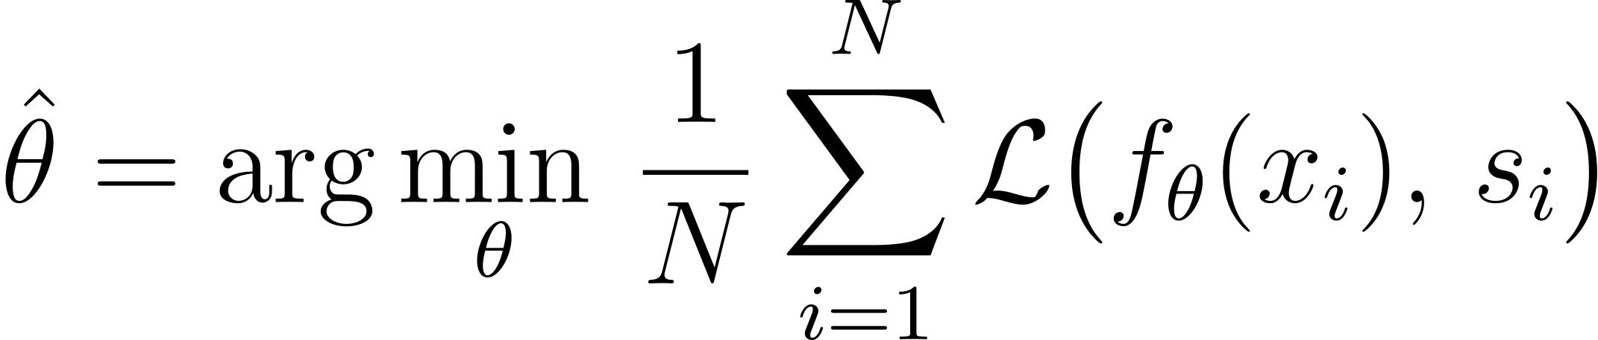
Style Editing Model
Learning the style
•Inputs: features (global + per-region) + your past edits
•Models: kNN retrieval → Ridge/MLP (with output constraints)
•Loss: MAE/Huber on sliders; Evaluation: parameter MAE and rendered
∆E2000/LPIPS
Akhundov, Lamsal, Yadav
Image Processing for Data engineers: Project Presentation

Slide 14
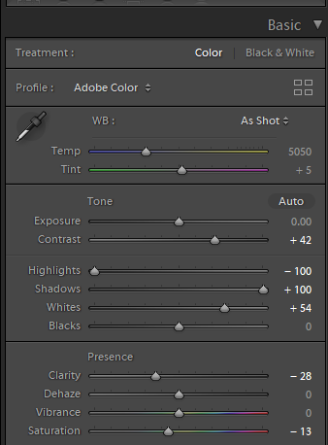
Style Editing Model
Inference on a new image
Compute features → predict sliders (exposure, WB, curve, HSL, clarity, dehaze)
Hand off to the edit engine (next slide)
Akhundov, Lamsal, Yadav
Image Processing for Data engineers: Project Presentation

Slide 15
Apply Edits — Edit Engine
Order
1. White balance (per-channel gains)
2. Exposure (linear RGB gain)
3. Tone curve / S-curve (monotonic spline)
4. HSL tweaks (masked by class)
5. Clarity/Unsharp (edge-aware; capped on faces)
6. Dehaze (e.g., dark channel prior) for sky/background
Akhundov, Lamsal, Yadav
Image Processing for Data engineers: Project Presentation

Slide 16
Conclusion
Content-aware masks + simple features ⇒ interpretable, personalized edits
Clear separation: Perception (frozen/finetuned) vs. Style (learned from you)
Private, repeatable, and fast for batch workflows
Next steps
Active learning on weak classes; face/skin constraints; depth-aware falloffs
Larger fine-tuned segmenter (when hardware permits)
Akhundov, Lamsal, Yadav
Image Processing for Data engineers: Project Presentation

Slide 17
https://www.linkedin.com/pulse/modnet-remove-background-real-time-demo-code-included-sobh-phd/
World of Depth – 6/17/24
Blend If vs Luminosity Masks | Stephen Bay's Photography Blog

